Slide 1


Cloud Native Java
John Ferguson
Platform Architecture
@fergusonjohnw

Slide 2
Agenda
 | Topics
1 | What is Cloud Native Java
2 | Spring Boot
3 | Spring Cloud
4 | Spring Cloud Data Flow
5 | Where do we go from here?
Notes:
What makes this possible is the fact that we have available to us infinite amounts of inexpensive computing power and storage power. A lot of this intelligence is driven by the fact that you can throw computing power and storage resources at the problem in a way that you simply could not do before.
If you look at the disruptive companies in the world, this is exactly what they're doing. They are taking lots of information, analyzing it in real-time, adding intelligence and using modern techniques to reshape industries and construct new business models.

Slide 3
Cloud Native Java

Slide 4
12-factor applications written in Java, ready to run anywhere, typically microservices

Slide 5
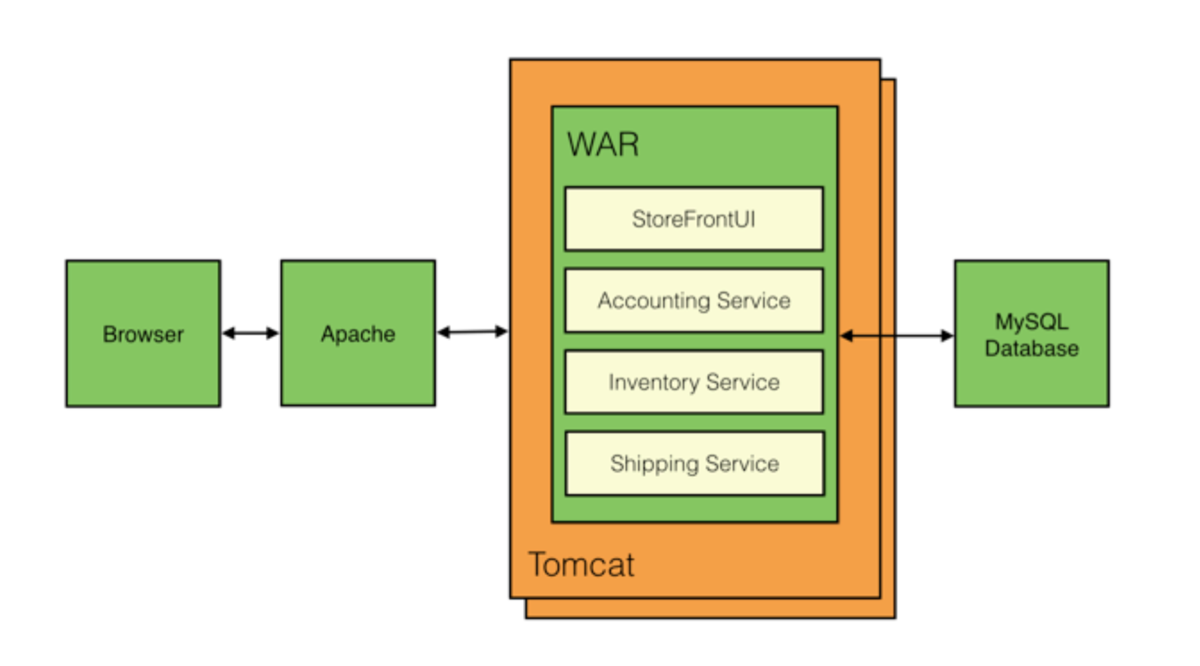
Monolithic Architectures

Slide 6
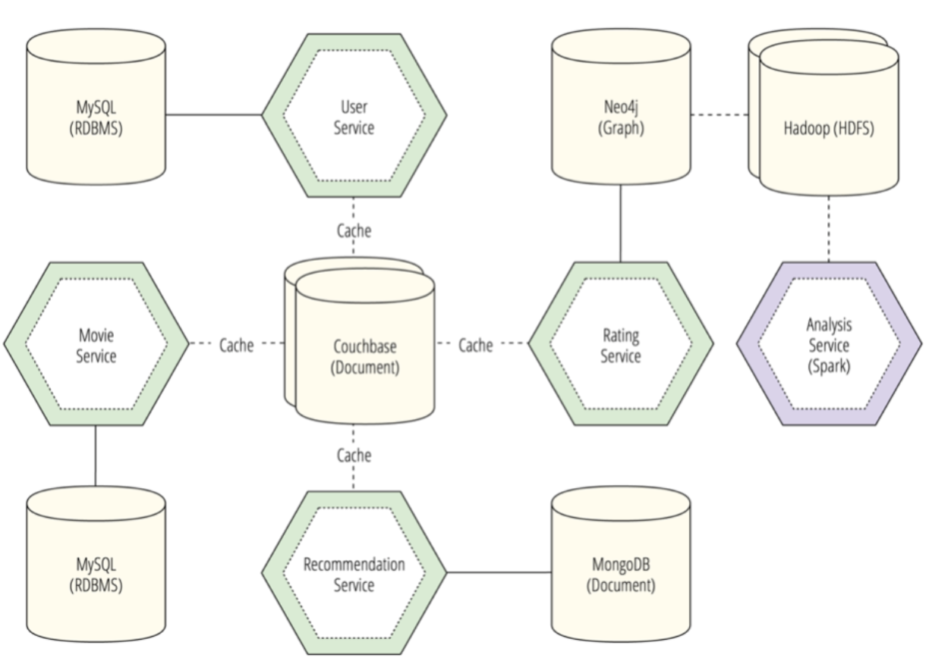
Microservice Architecture
One service, one database
Shared caches provided by platform for consistency

Slide 7
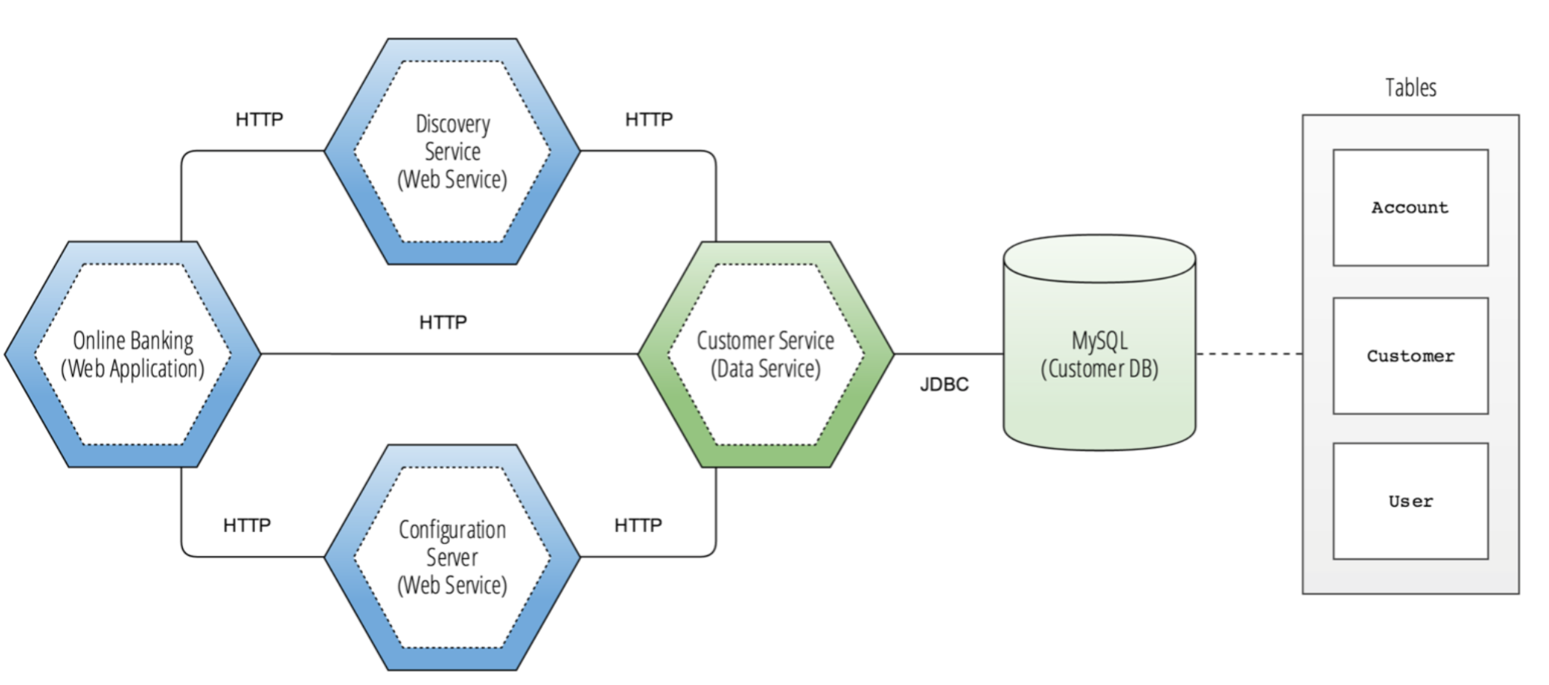
Monolithic to Microservice

Slide 8
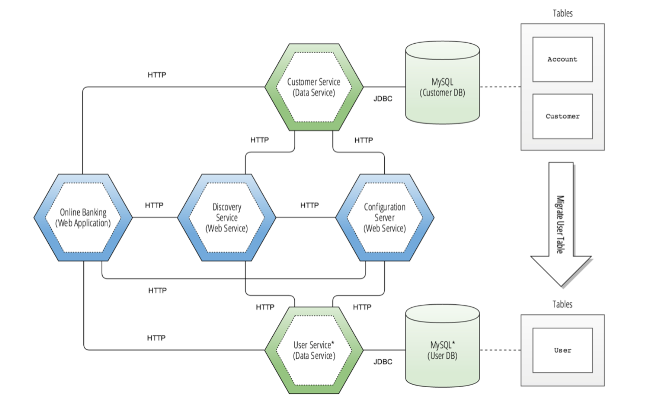
Monolithic to Microservice

Slide 9
What is Spring Boot?

Slide 10
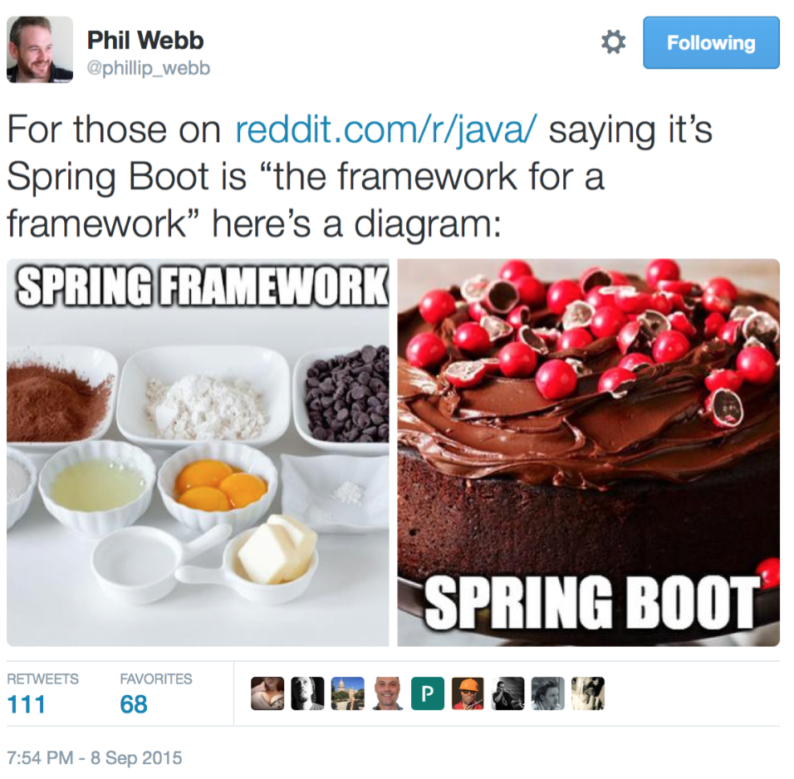
Who doesn’t like cake?

Slide 11
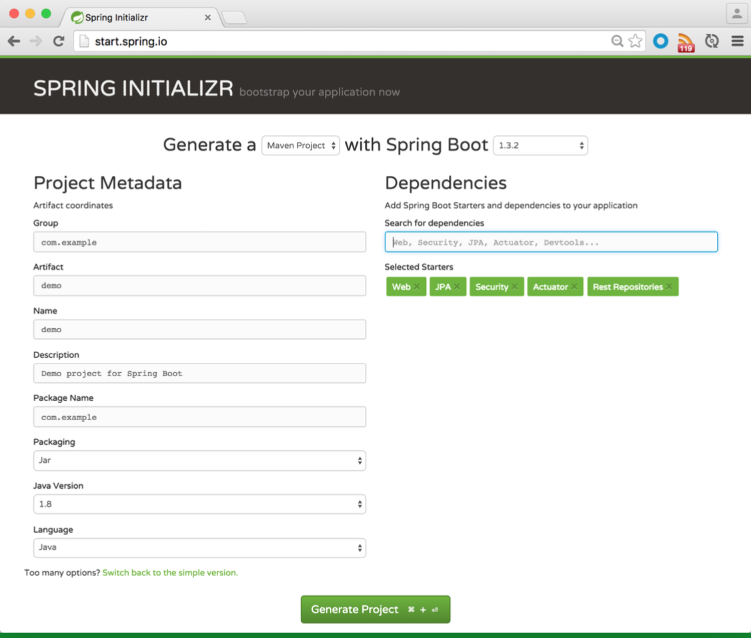

Spring Boot
Rapidly build production ready 12 Factor Apps
Focus on the logic not the plumbing
Get started quickly with start.spring.io

Slide 12
Let’s see it action
Download a spring boot starter from start.spring.io
Import into IDE
Add a REST Controller with Hello World Endpoint
Integrate security
Change endpoint to return logged-in user
Profit $$$

Slide 13
What is Spring Cloud?

Slide 14
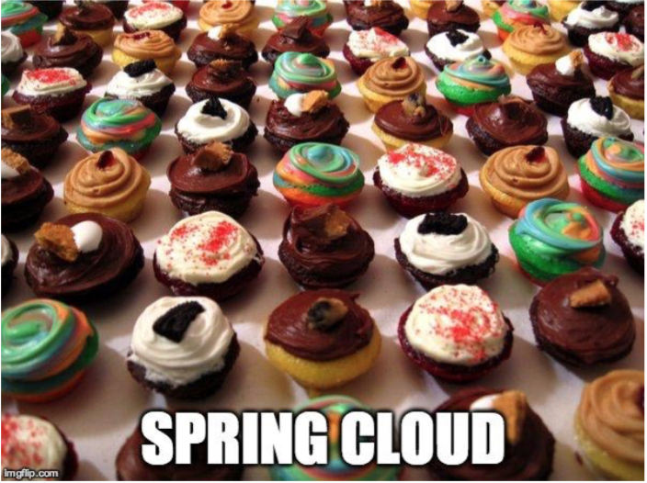
Turn Spring Boot microservices into Distributed Applications

Slide 15
Spring Cloud
Service Discovery (Eureka)
API Gateway (Zuul/Ribbon)
Config Server
Circuit Breakers (Hystrix, Turbine)
Distributed Tracing (Zipkins)

Slide 16
What is Spring Cloud Data Flow?

Slide 17

Spring Boot Microservices into Data Microservices

Slide 18
What is Spring Cloud Data Flow?
a cloud native programming and operating model for composable data microservices on a structured platform

Slide 19
Spring Cloud Data Flow
The Artist Formerly Known as SpringXD
Declarative data pipelines
Scalable data services
Automatic Fault Tolerance and Failover
Enterprise Integration Patterns ready for the Cloud
Use case: ETL, Real Time Analytics, Batch Processing, many more

Slide 20
Quick view
Deploy the Spring Cloud Data Flow Server
Deploy two Data microservices to SCDF
Connect to SCDF Server
Deploy a stream to pipe messages to log
Profit $$$

Slide 21
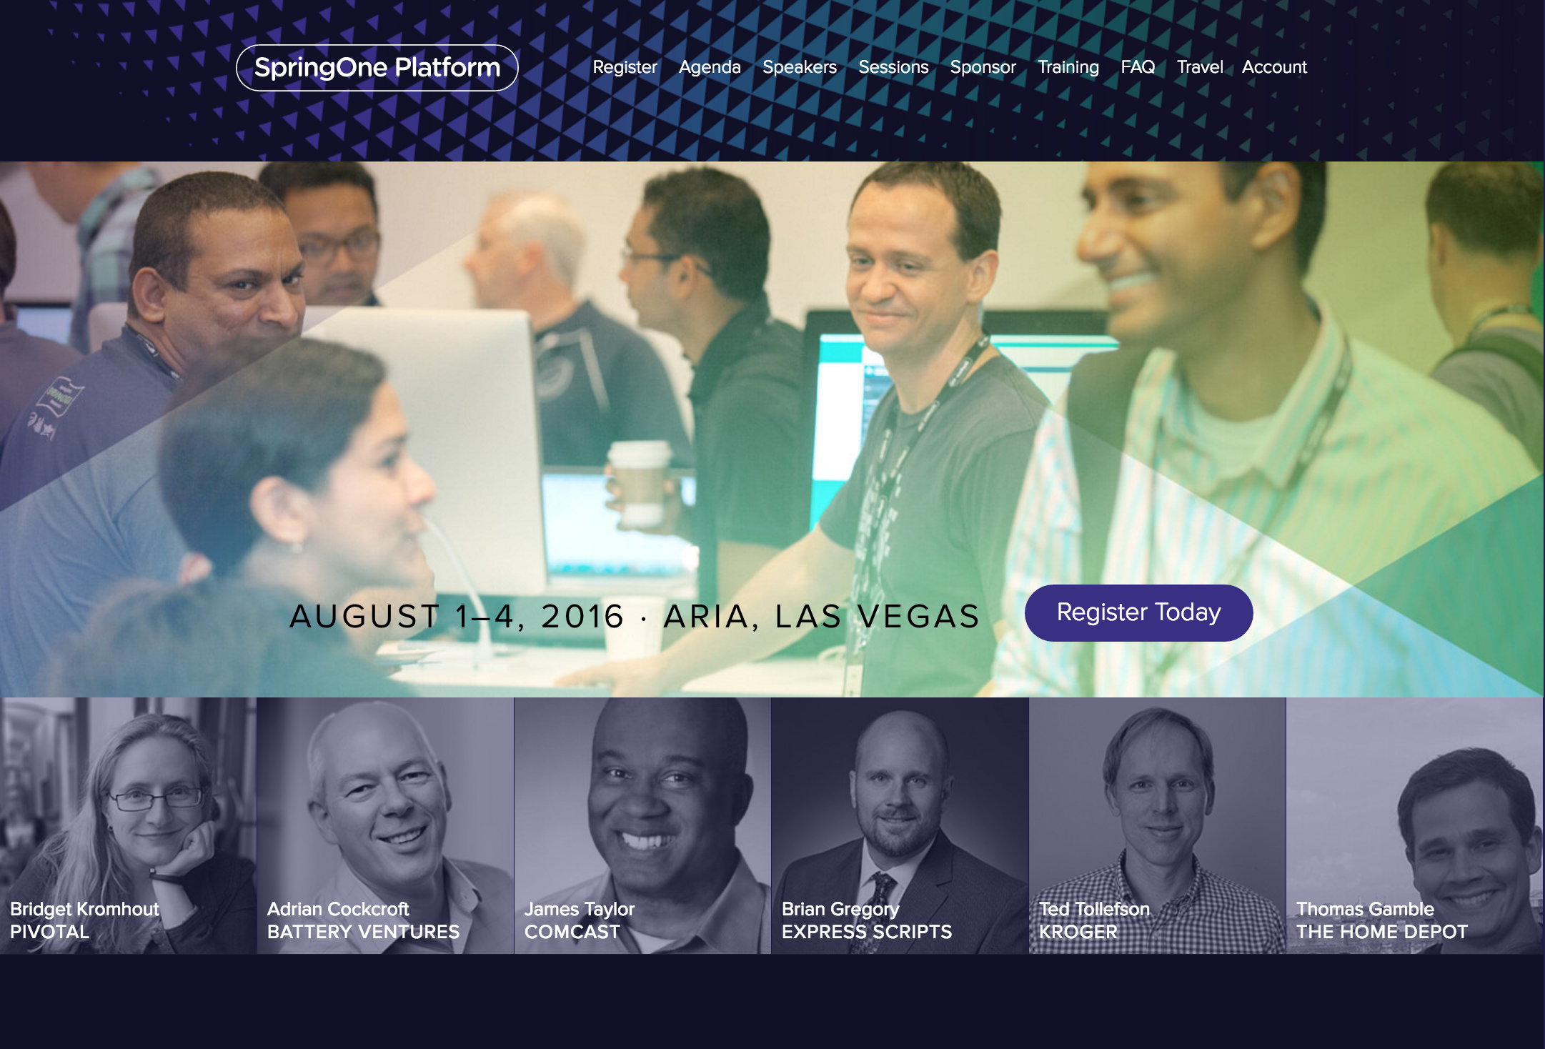
Quick view
Cloud Native Roadshow. Coming to a city near you!
http://pivotal.io/event/pivotal-cloud-native-roadshow
Want your own workshop? We like to travel!
Sign up for SpringOne Platform.
https://springoneplatform.io/
We have discount codes too.
Don’t worry, we put it all together for you.
https://raytheon.cfapps.io

Slide 22


